Slide 1






DevOps Transformation
Driving culture change
Ruly Weisbach, Lifecycle Management Director of R&D

Slide 2


Ruly Weisbach, Lifecycle Management Director of R&D
Managing Dev teams for 15 years
Joined HPE at 2011
Managed Agile Manager R&D, HPE first true SaaS product delivered in a continuous delivery manner
In the past three years managing ALM & PPM R&D
BA in Computer Science
MBA specialized in organization management

Slide 3

The ALM Story
8000+ Customers
Large scale enterprise system supporting thousands of users
1.5 Years
The average time for ALM release
300 Engineers working on ALM most with 10+ years on the project
Monolith solution design based on technical layers

Slide 4

Then came ALM Octane
SaaS 1st product
Reaching MVP in 6 months
New architecture and technologies
Push to production every 2 weeks
New solution in the ALM domain
Doing things the Agile way

Slide 5

Agile
Deliver the most important things first
Priorities

Slide 6




Drive ownership and accountability
Services instead of monolith
Release barriers, encourage trust
Focus on the value we want to deliver
Quality Management
Agile Management
DevOps Analysis
Project Management
Org structure with vertical teams Each responsible on End 2 End domain.

Slide 7




But my group leaders refused to accept the change. They wanted to maintain the layers model.
UI
Because its not efficient
Because this is how the used to work and they will make the layers seamless.
DAL
Because its too much of a change and the engineers will not accept.
Logic
Because developers love to develop only in one technology and want only one expertise
Platform

Slide 8




Things don’t come together at the end of the sprint
Impossible to track features progress
Soon they found out that doing Agile with a layered org model is not as fun as they thought it would be.
Wasting time arguing on the process instead of building software
Each small task requires 12 managers to agree upon

Slide 9

And it turns out the developers don’t really like working like this.
The didn’t feel any sense of ownership or pride in what they accomplish
They waisted time in meetings instead of coding
Doing lots of work for nothing because no one uses what they wrote
The didn’t understand what they are trying to achieve or why the person in the other layers do the things he does
They thought they have very stupid managers

Slide 10

And still few managers could not accept the change
Eventually I needed to do an Org change
Changes in group management
Having two groups with larger and empowered teams that deliver E2E functionality
Architects responsible to govern cross teams core components
Focused on building generic components rather than functionality
Constantly complaining nothing good will come out working this way
Didn’t drive the culture change in their group
Blame the vertical approach in anything that didn’t work

Slide 11
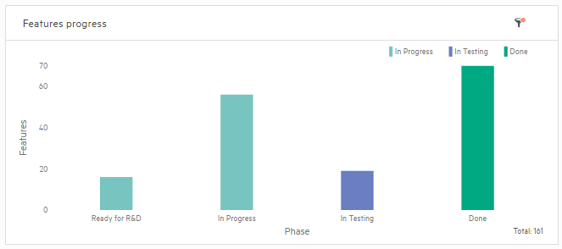
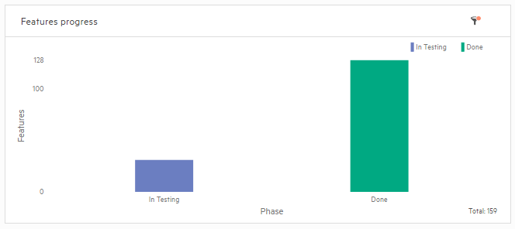
Release Features completion
Before
After
70 DONE
Features
128 DONE
Features
161 TOTAL
159 TOTAL
The productivity of the group almost doubled
The group motivation is at its peak
People are accountable and feel that what they do matter

Slide 12

Securing The Blurred Boundaries: Engineering Security in DevOps Era
Tomer Gershoni, Director & Chief Products Security Officer for HPE Software
Notes:
Ruly was speaking about the culture change he had to go through with his team during his Agile DevOps transformation.
Now I’d like to share with you the adventure we’ve been going through to embed security to our Agile and DevOps frameworks throughout the HPE software portfolio.

Slide 13


Tomer Gershoni, HPE Software Director & Chief Products Security Officer
Have been to Information/Cyber Security space for more than 15 years
Joined HPE at 2010
Lead Security for HPE SaaS as CISO
In the last four years, leading HPE Software Engineering Security Program
Notes:
My name is Tomer Gershoni and in the last 4 years, I’ve been leading the Engineering Security program for the HPE Software business as the head of the “Security & Trust office”.
In my 15 years in the Information/cyber security industry, I’ve seen a lot of organizations, IT environments, technologies and security solutions to theoretically every security threat that exist out there.

Slide 14



Current State: Disconnect
Builders
Defenders
Notes:
But there is one significant point either the IT or Security industries have not succeeded to tackle or resolve, and that is the disconnect between the builders, R&D or IT Operations and defenders, which are mostly the CISOs and their delegates.

Slide 15
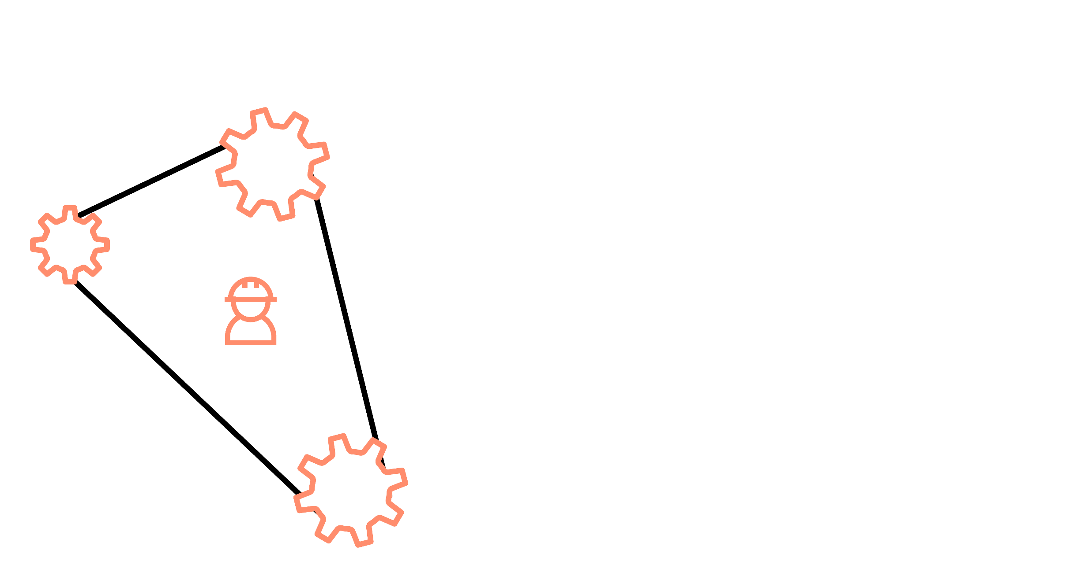
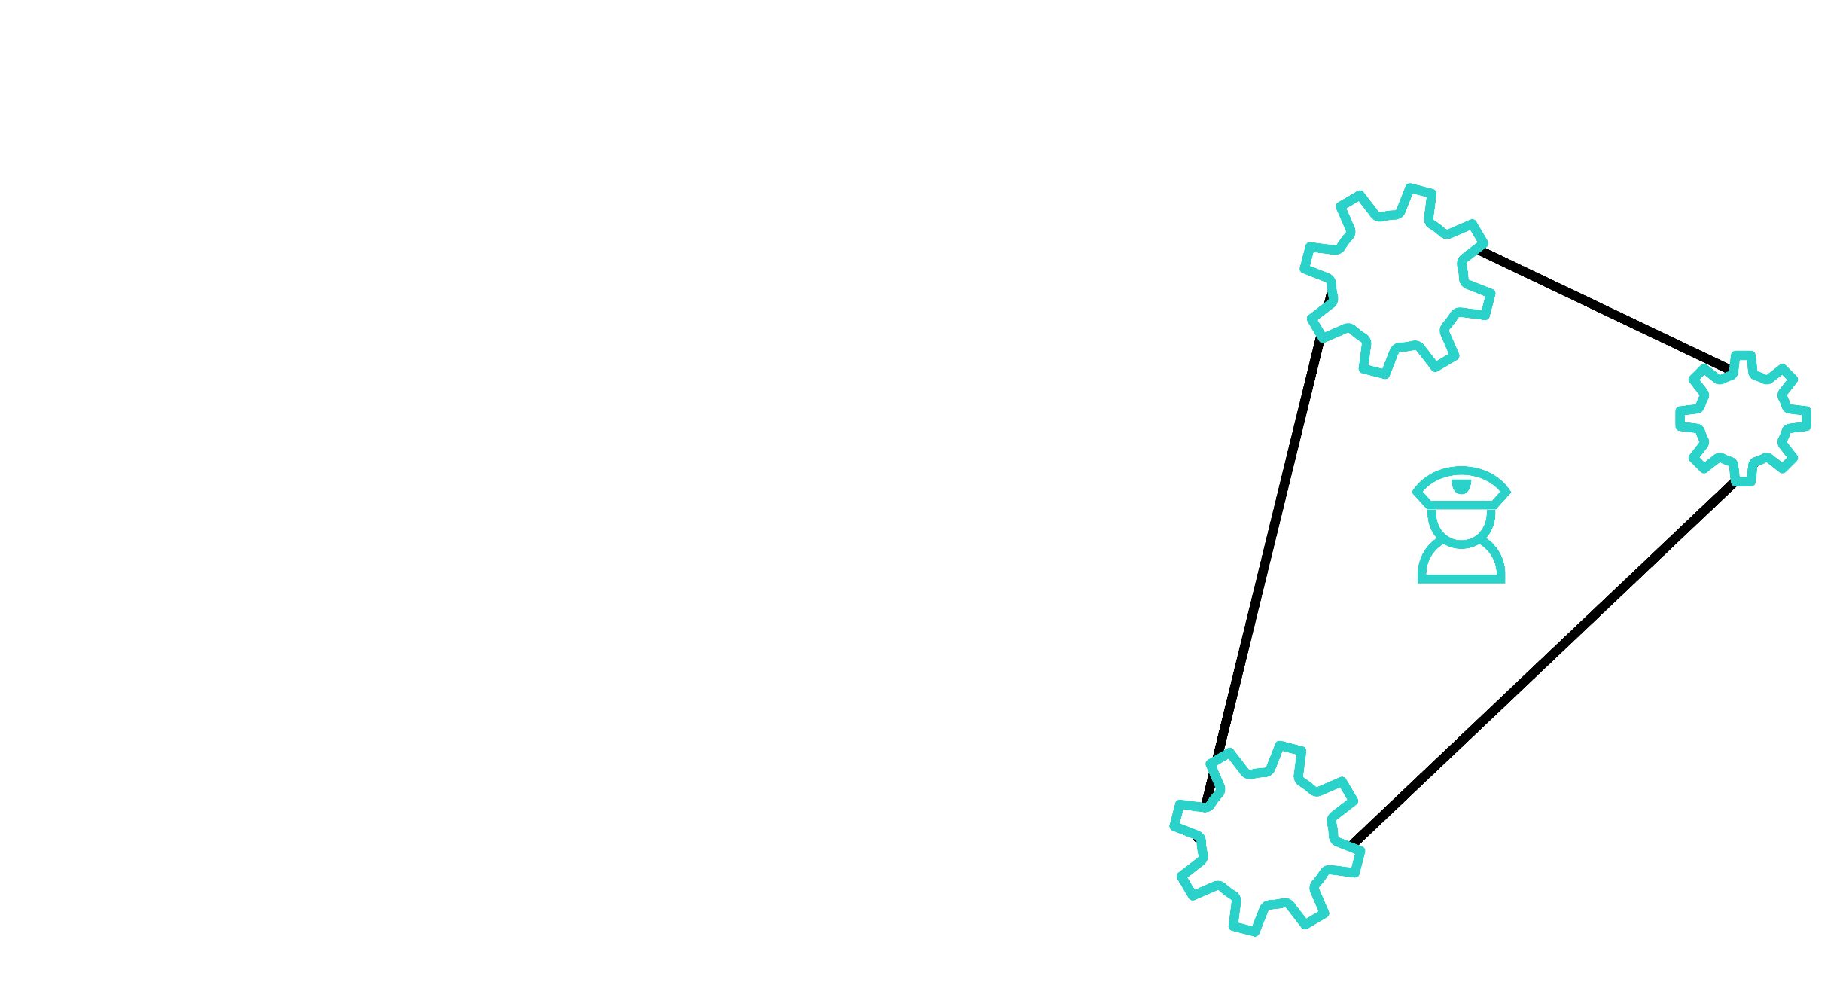
HPE Software – True Story
Management
Management
Methodology
Methodology
Builders
Defenders
VS.
Tools
Tools
Notes:
When we’ve ran an internal root cause analysis of the problem internally, in HPE SW, we’ve found out that the disconnect is pretty obvious considering the fact that the two communities are using two different Management systems, methodologies and testing tools which run in completely separate echo systems.

Slide 16
Breaking the security problem to pieces
Today
Security not embedded in DevOps
Tomorrow
Run security continuously throughout the development cycle
Software Security Risks
Release Kickoff
Security Scan
Push to Production
Large, costly unmanageable problem impacts product security and increase development cost
Release Kickoff
Push to Production
Many small problems resolved throughout the process
Dev team learns continuously and reduces new risks introduction over time
Notes:
And this disconnect caused every release cycle to end with one big security problem. A problem that is not only large, costly and hard to manage but also created fire drills for every given release we wanted to push to production.

Slide 17
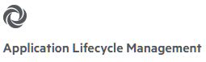


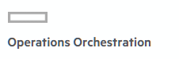
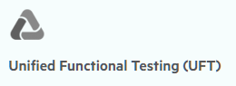

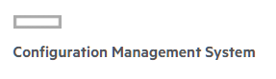
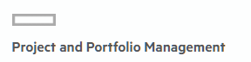
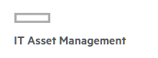
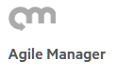
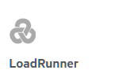
HPE Software Engineering Security Program
Embed security into software engineering lifecycle
80 Enterprise Software Products
Products Release cadence: from weeks to months
12M lines of code being scanned daily (20M at picks)
4 Years of Operations
5000 R&D Engineers
Notes:
The challenge with resolving this disconnect was getting even more complicated due to the size and complexity of the portfolio. HPE Software is an organization with more than…
So it was not only doing security to an unresolved industry problem but to do that in a large scale.

Slide 18
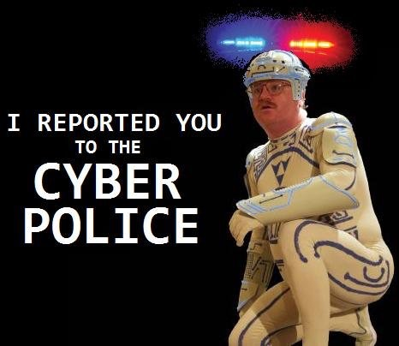


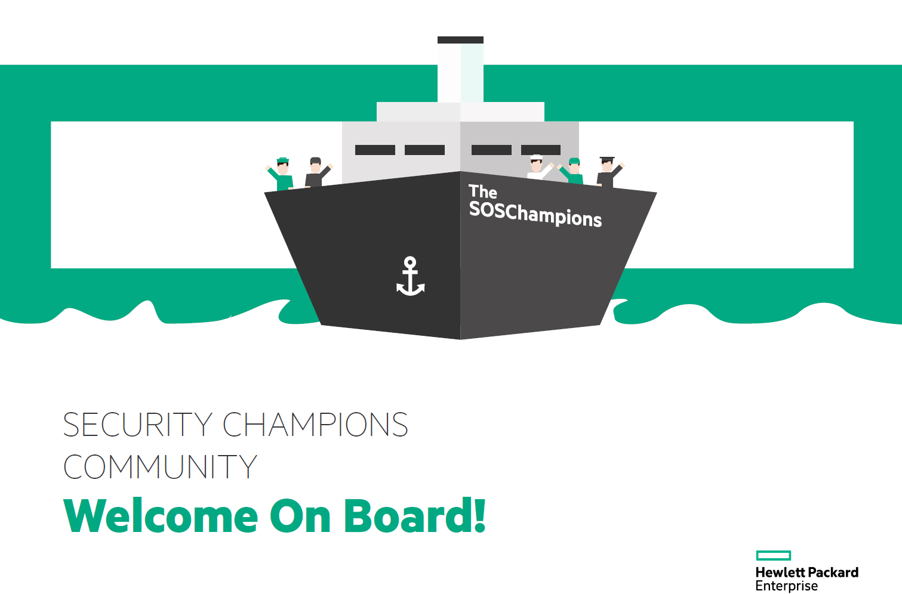
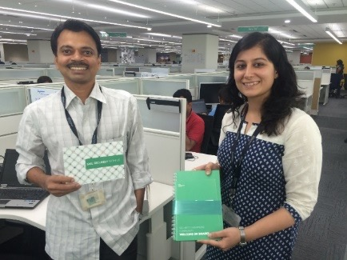
Turning security into an Experience an Breaking the silos
2500
Trained Engineers on “How to protect the code I’m writing”
Build a “Security Champions” community which improved the integration of security into the teams
Notes:
Let me give you a few examples of how we’ve done that.
We started breaking the silos by embedding security into the organizational culture.
We, my team, wanted to avoid from the “central police” image and wanted to be branded as the “community police” so we started with branding ourselves as such.
Together with that, we’ve started training 2500 engineers on how to protect the code they’re writing. Those were “in person” secure coding training, provided to the specific technology that is used by the specific product team and included hands on lab.
In addition, we’ve established our security champions community which helped us to have a better footprint into the day2day of R&D and improved integration of security into the team.

Slide 19









Align Security with Agile Processes and Tools
Education
Requirement and planning
Release
Response
Design
Implement
Verify
Deploy
Security Plan
Threat Modeling
Design Review and mitigation
Security risk assessment
Sign Off
Planning
Design
Dev
QA
Feature Freeze
Code freeze
GA
Notes:
We started with taking our Security Lifecycle framework and ensured that the main tasks there are aligned with agile sprints:
Security planning aligned with release plans and sprints.
Run feature based threat modelling to identify design risks early in the lifecycle.
Build a service for R&D to run security test automation independently.
Align the hands on penetration testing with the release cadence and sprints.
Document all risks: Design, automation, and hands on in the R&D defect management systems so everyone will be looking at the same backlog.
Then we’ve met with our DevOps leaders in the organization and brainstormed on how to embed those processes to the release sprints, timeframes and milestones.
And that was the final result.

Slide 20



Agile risk management – Transparency and continuous control over risk
Risk sources
Risk calculator
Risk Business Context
 | Risk Parameters | Values
1 | Damage Potential: Confidentiality | 2
2 | Damage Potential: Integrity | 2
3 | Damage Potential: Availability | 2
4 | Reproducibility | 2
5 | Exploitability: Skills | 3
6 | Exploitability: Access Vector | 2
7 | Availability: Affected tenants | 0
8 | Availability: Affected users | 3
9 | Discoverability: Skills | 3
10 | Discoverability: Attack surface | 3
Design risks
STAT
Hands on assessments
Customer reports
Vulnerability Severity: 8.3, High
$$Σ$$
High criticality
Product Vulnerability Score (VS)
Product Criticality
Medium criticality
Low criticality
Product Risk profile
Notes:
And last, we’ve developed a new methodology for risk management: Agile risk management. The objective of that methodology is to provide our product teams with a tool to manage risk with transparency and control required for the dynamic nature of DevOps.

Slide 21


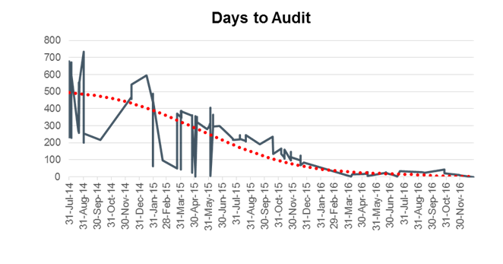

And the change started to happen
Culture Change
Total identified vulnerabilities through time
84%
Heartbleed: Accelerate Response Time
of the trained engineers believed they can immediately implement the tools they’ve learned
Newly identified Security Vulnerabilities dropped to ~0
Days to review (audit)
Risk reduction and minimum compromises
48 Hours to Release a Public Response for more than 80 Enterprise Software Products
30%
YoY Reduction in the Portfolio Vulnerability Score
Reduction of 500% in R&D time to audit security issues
Notes:
And the change started to happen:
In surverys we’ve ran post the trainings, 84% of the engineers said they’re able to immediately implement the tools they’ve learned.
The R&D efforts in analyzing the security testing automation tools results dropped from months to hours.
The number of identified vulnerabilities in the hands on testing is dropping continuously. The graph here shows a real product that in it’s latest pen test cycle did not succeed to find any new vulnerabilities.
We’ve seen 30% reduction in the portfolio VS YoY.
But most important is the heart, or making sure it will not bleed.
Due to the tight alignment and comprehensive tools and process integration we’ve succeeded to release an official public response of our portfolio impact to heartbleed in less than 48 hours.
We did not sleep throughout that time but keeping our R&D managers happy, our ITOPS managers happy and most importantly, keeping our customers happy.

Slide 22

Thank You!
rulyw@hpe.com
tomerg@hpe.com

